Slide 1

DATA ANALYSIS AND ESSENTIALS
STUDENT PERFORMANCE DATA
ANALYSIS SYSTEM
Review1
PRESENTED BY
S. Moreblessing 25B11CSA74
D. Praneela 25B11CS209
G. Sai Sri Keerthi 25B11CS261
K. Shabreen 25B11CS429

Slide 2
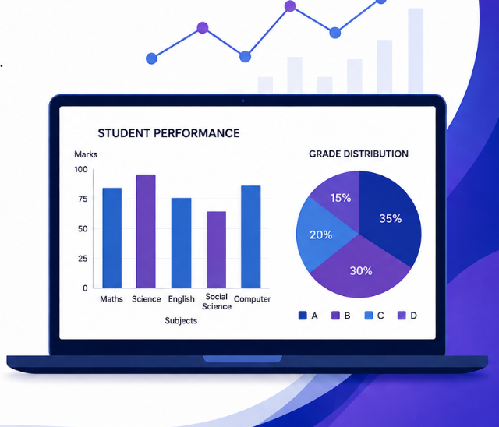
INTRODUCTION
Student Performance Data Analysis System is a data analysis project designed to analyze and understand students' academic performance using Python, Pandas, and Matplotlib.
📊 Collects and manages student performance data.
🔍 Performs sorting, filtering, and calculations on the dataset.
📈 Calculates important metrics such as total marks, average, and grade.
📉 Uses bar graphs and pie charts to visualize performance.
🎯 Helps identify top performers, weak areas, and overall performance trends.
📄 Generates meaningful reports from the analyzed data.

Slide 3

Problem Statement
Student performance data contains important information about academic results and other factors related to students. However, analyzing a large amount of student data manually can be difficult and time-consuming. It may also be challenging to identify performance patterns, compare students, and find the factors that influence academic results.
📊 Difficulty in analyze the large amounts of student data.
⏱️ Manual analysis is time-consuming.
⚠️ Difficult to identify low-performing and high-performing students.
📈 Performance trends are not easily visible.
🔍 Difficult to identify factors affecting student performance.
📄 Need for clear and meaningful reports from the data.

Slide 4

Objectives
The main objective of this project is to analyze student data and understand their academic performance. The project aims to extract useful information from the dataset and present it in a simple and understandable way.
📊 Analyze student academic performance.
🔍 Identify patterns and trends in student data.
📈 Compare students' performance.
🎯 Identify factors affecting academic results.
⚠️ Find high-performing and low-performing students.
📄 Generate meaningful insights from the data.

Slide 5
Attributes
Attributes | Definition | Data type
Roll Number | Unique identification of student | Integer(int64)
Student Name | Name of the Student | Categorical(object)
Subject Name | Marks obtained in each subject | Categorical(object)
Total Marks | Sum of subject Marks | (Numerical)
Average Marks | Average of marks obtained | Numerical
Percentage | Overall percentage | Numerical
Grade | Grade based on performance | Categorical(object)

Slide 6
📊 DATA ANALYSIS
Data analysis is the process of examining and interpreting data to find useful information, patterns, and relationships. It helps convert processed data into meaningful insights that can support better decisions.
🎯 Uses of Data Analysis
📈 Understand Performance – Helps understand the academic performance of students.
🔍 Find Patterns – Identifies patterns and trends in student results.
🎯 Identify Factors – Helps find factors that may affect student performance.
👥 Compare Students – Allows comparison between different groups of students.
🧮 Calculate Results – Helps calculate total, average, minimum, and maximum scores.
💡 Support Decisions – Provides useful insights for improving student performance.

Slide 7
Dataset
The dataset is used to study and analyze student academic performance. It contains information about students and different factors related to their academic results. The dataset was obtained from Kaggle in CSV format and was loaded into Google Colab for cleaning, preprocessing, and analysis.
🎓 Contains student academic performance records.
📁 The dataset was collected from Kaggle.
📄 The dataset is available in CSV format.
☁️ The CSV file was uploaded and accessed through Google Colab.
🔗 Google Drive was mounted to Google Colab to access the dataset.
🧹 The data was prepared for cleaning and preprocessing.
📊 The dataset is used to identify patterns and factors affecting student performance.

Slide 8
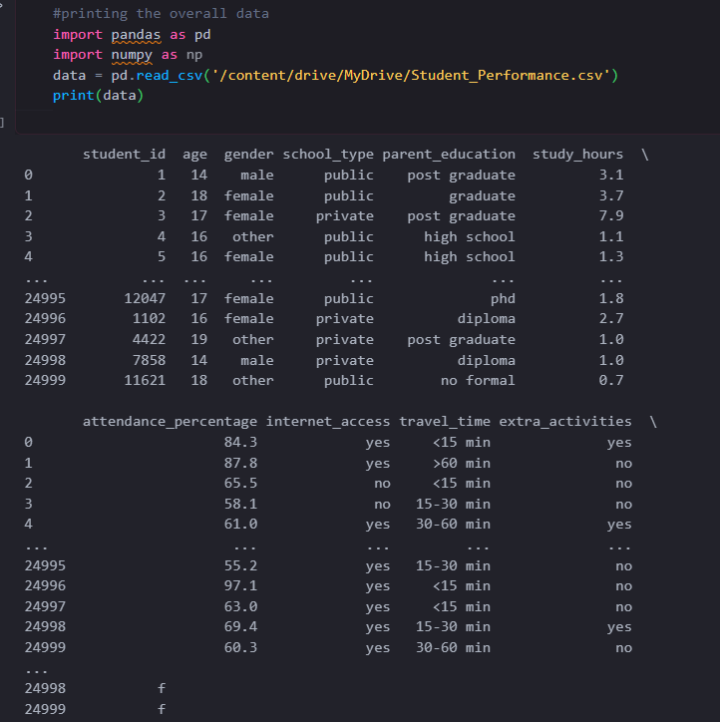
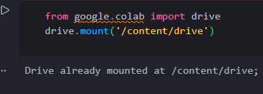
🐼 The dataset is loaded using Pandas for analysis.
👀 The displayed table shows the student records and their attributes.
☁️ DATASET COLLECTION & LOADING
🔗 Google Drive is mounted with Google Colab to access the dataset.

Slide 9
🧹 DATA CLEANING
Data cleaning is the process of checking and improving the quality of the student dataset before performing analysis. It helps ensure that the data is accurate, consistent, and ready for further processing.
🔍 head() – Used to display the first 5 records of the dataset.
👀 tail() – Used to display the last 5 records of the dataset.
📐 shape – Used to find the number of rows and columns in the dataset.
❌ isnull() – Used to check for missing values in the dataset.
🧹 dropna() – Used to remove records containing missing values when required.
🔄 duplicated() – Used to identify duplicate records.
✅ Cleaning the data helps make the dataset consistent and suitable for analysis.

Slide 10
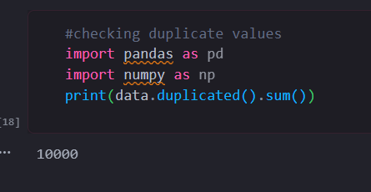
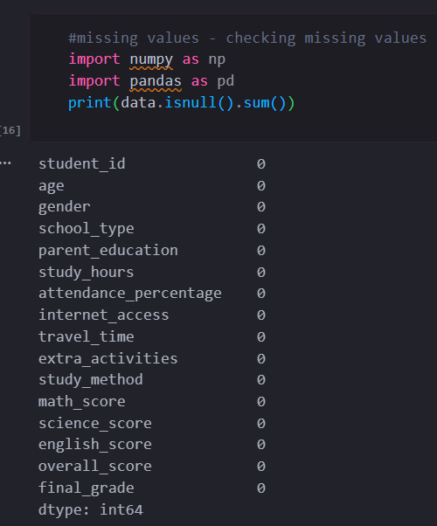
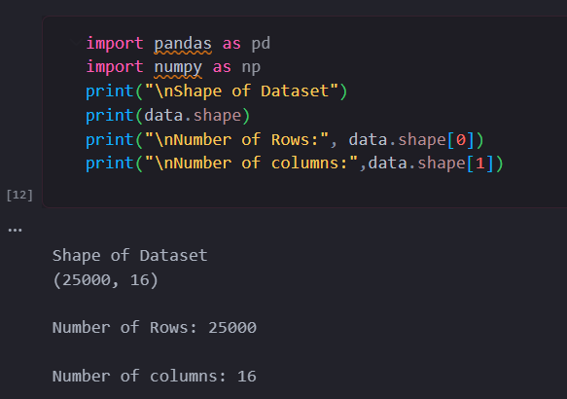
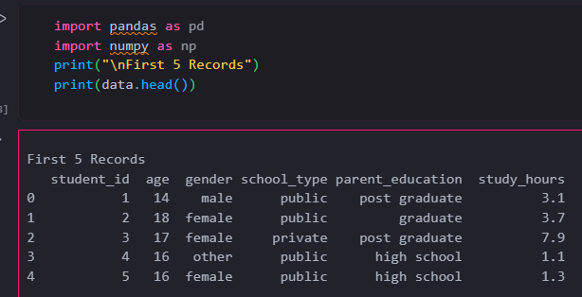
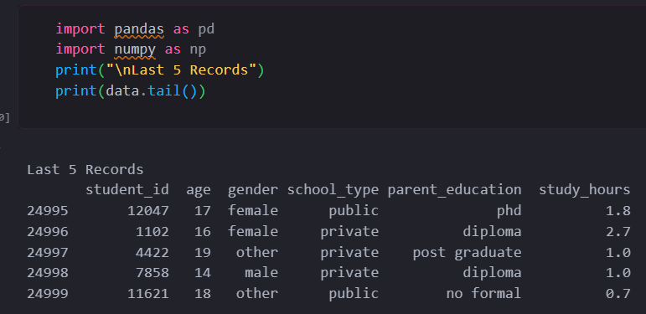
🔄 duplicated() – Used to identify duplicate records.
📐 Dataset Shape – Shows the total number of rows and columns.
❌ isnull() – Used to check for missing values in the dataset.
🔍 head() – Used to display the first 5 records of the dataset.
👀 tail() – Used to display the last 5 records of the dataset.

Slide 11
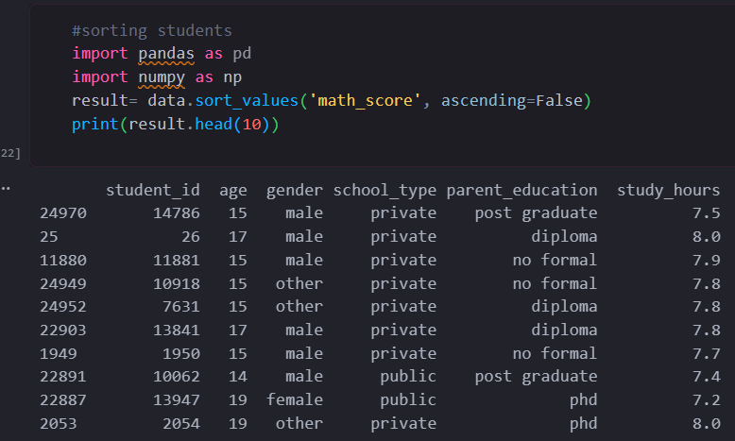
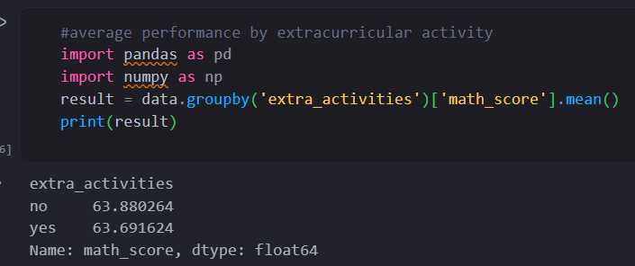
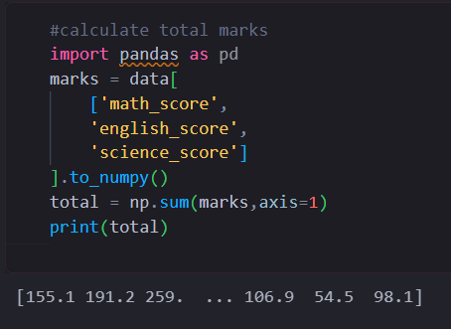
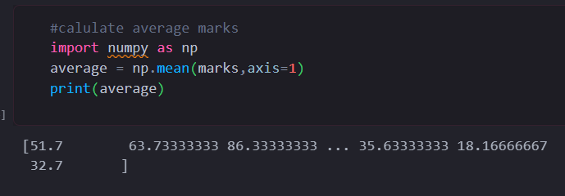
⚙️ DATA PREPROCESSING
🔽 Sorting Students – Sorts students according to their Math scores in descending order.
🎯 Extracurricular Analysis – Calculates the average Math score based on extracurricular activities.
🧮 Total Marks – Calculates the total marks obtained in Math, English, and Science.
📊 Average Marks – Calculates the average marks of each student across the three subjects.

Slide 12

🖥️ SYSTEM REQUIREMENTS
The project can be performed using a basic computer system with an internet connection because the analysis is carried out using Google Colab.
💻 Computer/Laptop – Required to access and run the project.
🌐 Internet Connection – Required for Google Colab and Google Drive.
☁️ Google Account – Required to access Google Colab.
🧠 RAM – 4 GB or above is recommended.
🌐 Web Browser – Chrome, Edge, or Firefox can be used.
💾 Storage – Required for storing the CSV dataset and project files.

Slide 13
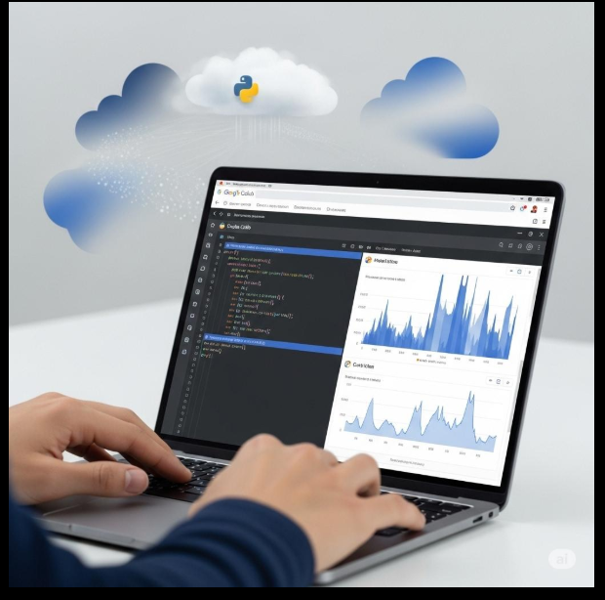
💻 TECH STACK
The project uses a combination of Python libraries and cloud-based tools to clean, process, analyze, and visualize the student dataset.
🐍 Python – Used for programming and data analysis.
🐼 Pandas – Used for data cleaning and manipulation.
🔢 NumPy – Used for numerical calculations.
📊 Matplotlib – Used to create graphs and visualizations.
☁️ Google Colab – Used to write and execute Python code.
📄 CSV – Used as the dataset file format.

Slide 14

.
🚀 FUTURE ENHANCEMENTS
🤖 Performance Prediction – Use machine learning to predict student performance.
🎯 Early Identification – Identify students who may need academic support.
📚 Personalized Recommendations – Provide study suggestions based on individual performance.
📊 Interactive Dashboard – Create a dashboard for teachers to monitor student performance.
🔍 More Factors – Include additional factors such as learning behavior and study patters.
📈 Real-Time Analysis – Update and analyze student performance data regularly.

Slide 15
Conclusion
The Student Data Performance Analysis project helps us understand student academic performance by analyzing different factors related to their studies. The dataset was cleaned, processed, and analyzed using Python tools to identify useful patterns and insights.
🎓 Student performance was analyzed using different academic factors.
🧹 The dataset was cleaned and prepared for analysis.
⚙️ Data preprocessing helped make the data suitable for analysis.
📊 Charts and visualizations made the results easier to understand.
🔍 Important patterns related to student performance were identified.
💡 The analysis can help in making better decisions to improve student academic performance.

Slide 16
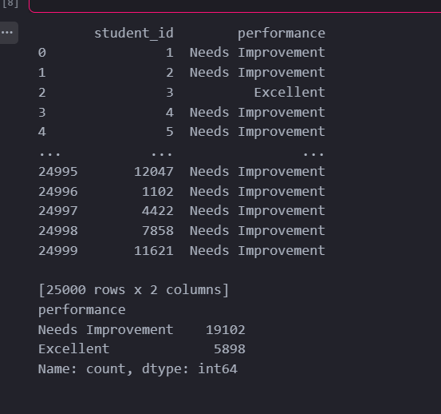
PERFORMANCE ANALYSIS
//output
//code
#performance category
import pandas as pd
import numpy as np
data['performance'] = np.where(
data['overall_score'] >= 80,
'Excellent',
'Needs Improvement’
)
print(data[['student_id','performance’]])
print(data['performance'].value_counts())

Slide 17
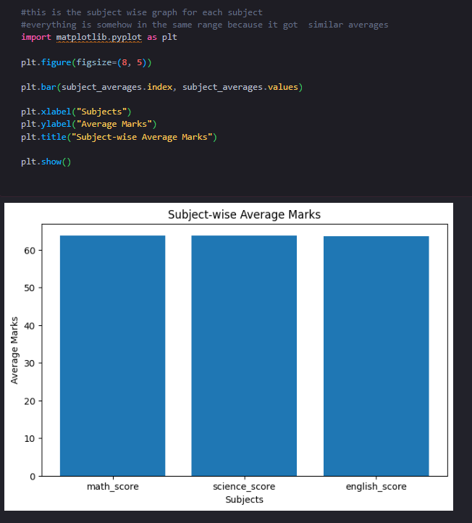
MARKS COMPARISON
//code
//output
import matplotlib.pyplot as plt
plt.figure(figsize=(8, 5))
plt.bar(subject_averages.index, subject_averages.values)
plt.xlabel("Subjects")
plt.ylabel("Average Marks")
plt.title("Subject-wise Average Marks")
plt.show()

Slide 18
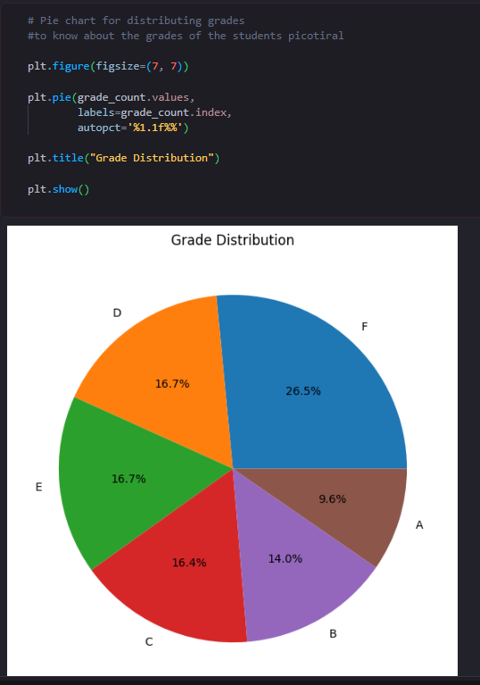
GRADE DISTRIBUTION
//code
//output
import matplotlib.pyplot as plt
plt.figure(figsize=(7, 7))
plt.pie(grade_count.values,
labels=grade_count.index,
autopct='%1.1f%%')
plt.title("Grade Distribution")
plt.show()

Slide 19
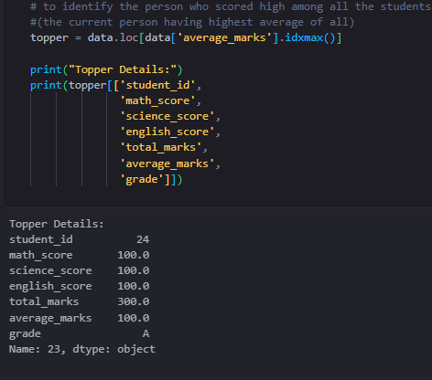
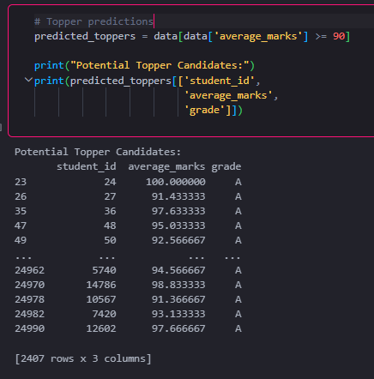
TOPPER PREDICTION/IDENTIFICATION
//code
//code
topper = data.loc[data['average_marks'].idxmax()]
print("Topper Details:")
print(topper[['student_id',
'math_score',
'science_score',
'english_score',
'total_marks',
'average_marks',
'grade']])
# Topper prediction
predicted_toppers = data[data['average_marks'] >= 90]
print("Potential Topper Candidates:")
print(predicted_toppers[['student_id',
'average_marks',
'grade']])
//output
//output

Slide 20
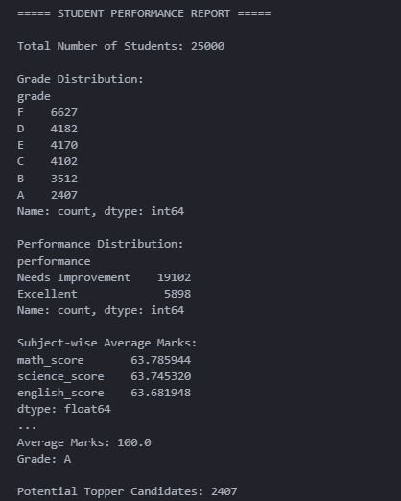
STUDENT PERFORMANCE REPORT
print("===== STUDENT PERFORMANCE REPORT =====")
print("\nTotal Number of Students:", len(data))
print("\nGrade Distribution:")
print(grade_count)
print("\nPerformance Distribution:")
print(data['performance'].value_counts())
print("\nSubject-wise Average Marks:")
print(subject_averages)
print("\nTopper Details:")
print("Student ID:", topper['student_id'])
print("Average Marks:", round(topper['average_marks'], 2))
print("Grade:", topper['grade'])
print("\nPotential Topper Candidates:",
len(predicted_toppers))

Slide 21


